Slide 1


2024 HCA Single-Cell Omics in-person Computational and Experimental Design Workshop Single-cell data integration and batch correction
June 24-28, 2024
Bangkok, Thailand

Slide 2
Computational track schedule
 | Beginner | Advanced
Monday | Preprocessing/QC | Data integration/cell type annotation/DE
Tuesday | Clustering/DE/data integration/cell type annotation | multi-omics/DA
Wednesday | TCR/BCR/CITE-Seq
Thursday | Trajectory inference/cell-cell communication
Friday | project/presentation

Slide 3
Today’s Outline
Sources of batch effects
Computational approaches to correct for batch effects and integrate data.
Examples of data integration

Slide 4
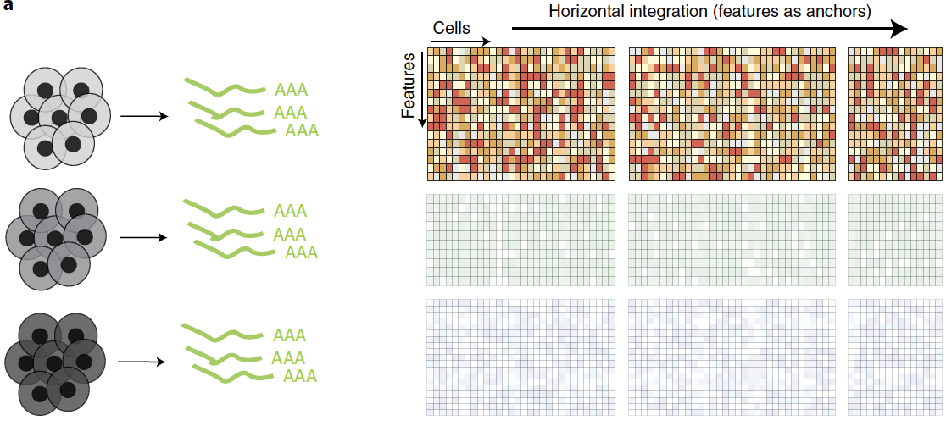
Data integration
Shared features across different batches of cells
Argelaguet R. et al. (2022) Nature Methods. 39:1202-125.
Notes:
In addition to RNA, we can profile many other cellular molecules. DNA- genome, epigenome- chromatin accessibility, methylation. Protein- mass cytometry. One particularly important advance is being able to make multiple different measurements on a single cell. Establish causality between RNA + protein or epigenome + RNA.

Slide 5
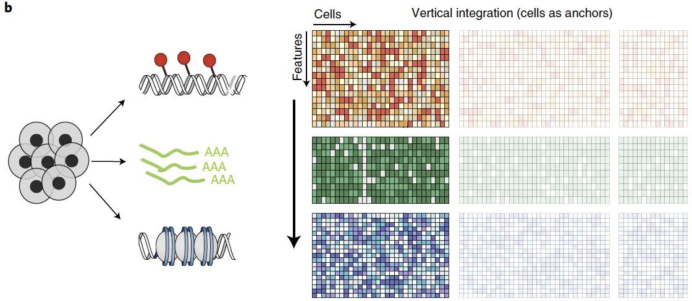
Data integration
Different features measured from same cells
Notes:
In addition to RNA, we can profile many other cellular molecules. DNA- genome, epigenome- chromatin accessibility, methylation. Protein- mass cytometry. One particularly important advance is being able to make multiple different measurements on a single cell. Establish causality between RNA + protein or epigenome + RNA.

Slide 6
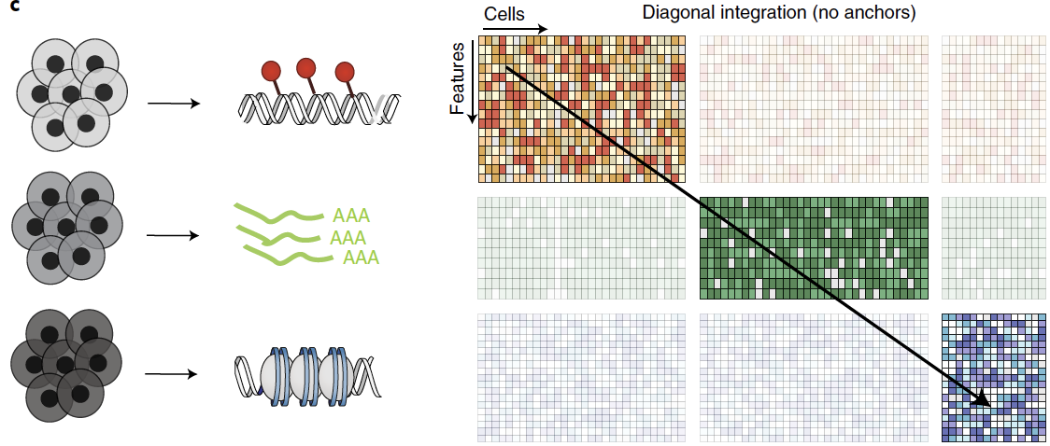
Data integration
Different cell batches and features in each experiment
Efremova M. et al. (2020) Nature Methods. 17:11-20.
Notes:
In addition to RNA, we can profile many other cellular molecules. DNA- genome, epigenome- chromatin accessibility, methylation. Protein- mass cytometry. One particularly important advance is being able to make multiple different measurements on a single cell. Establish causality between RNA + protein or epigenome + RNA.

Slide 7
Cells are colored by cell type. Symbols represent different batches.
Distinguishing biological effects from technical, batch effects is a difficult problem
Correcting for batch effects allows us to combine datasets and boost biological signal, while reducing technical confounders

Slide 8
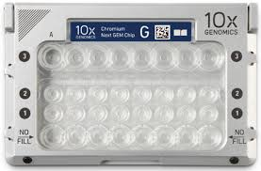
Batch effects: technical sources from experimental design
Completely confounded
v
Unconfounded
Biological condition 1
v
Biological condition 2
v
Biological condition 3
https://scrnaseq-course.cog.sanger.ac.uk/website/ideal-scrnaseq-pipeline-as-of-oct-2017.html

Slide 9
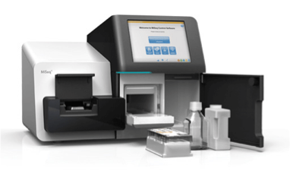
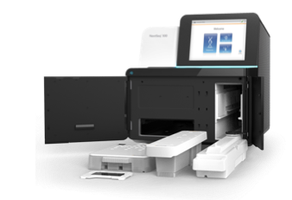
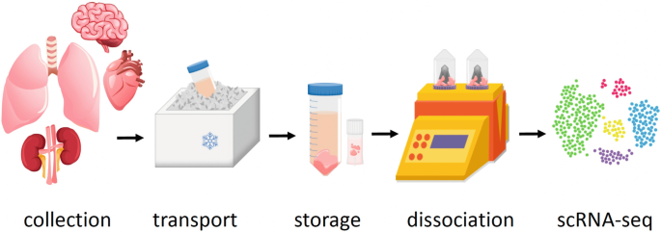
Batch effects: technical sources from experimental variation
Differences in how samples are sequenced
sequencing depth and saturation
sequencing instrument
Differences in how samples were collected
Site and time of collection
Experimental protocol used (i.e. tissue dissociation)
Miseq
~ 20M reads total
Nextseq
~ 500M reads total
HiSeq 4000
4 billion reads

Slide 10
Today’s Outline
Sources of batch effects
Computational approaches to correct for batch effects and integrate data
Examples of data integration

Slide 11
A few basic approaches to batch correction
Down sampling of sequencing reads
Normalization
Using variable genes common to multiple samples
Removing genes correlated with batch
Regression of residuals with technical covariates
batch id
number of UMI per cell
number of genes per cell
% mitochondrial reads
Notes:
Github site
Bookdown course site with labs

Slide 12
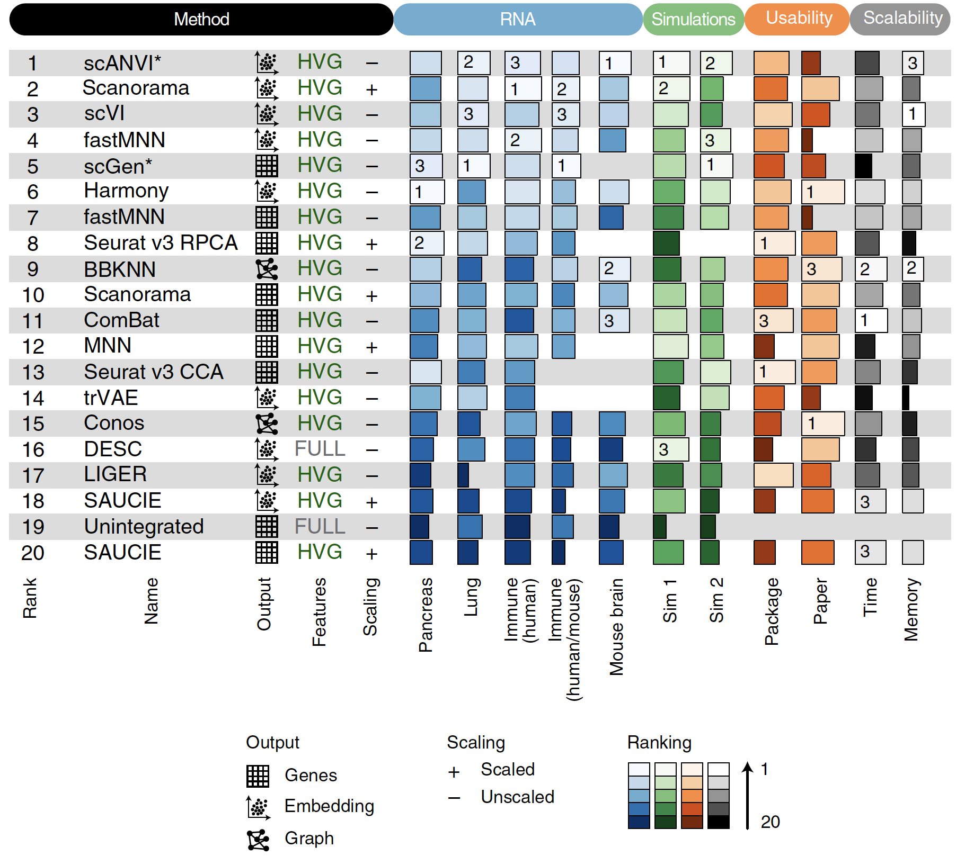
Many tools use some of these basic approaches
Luecken M. D. et al. (2022) Nature Methods. 19:41-50.
Notes:
In addition to RNA, we can profile many other cellular molecules. DNA- genome, epigenome- chromatin accessibility, methylation. Protein- mass cytometry. One particularly important advance is being able to make multiple different measurements on a single cell. Establish causality between RNA + protein or epigenome + RNA.

Slide 13
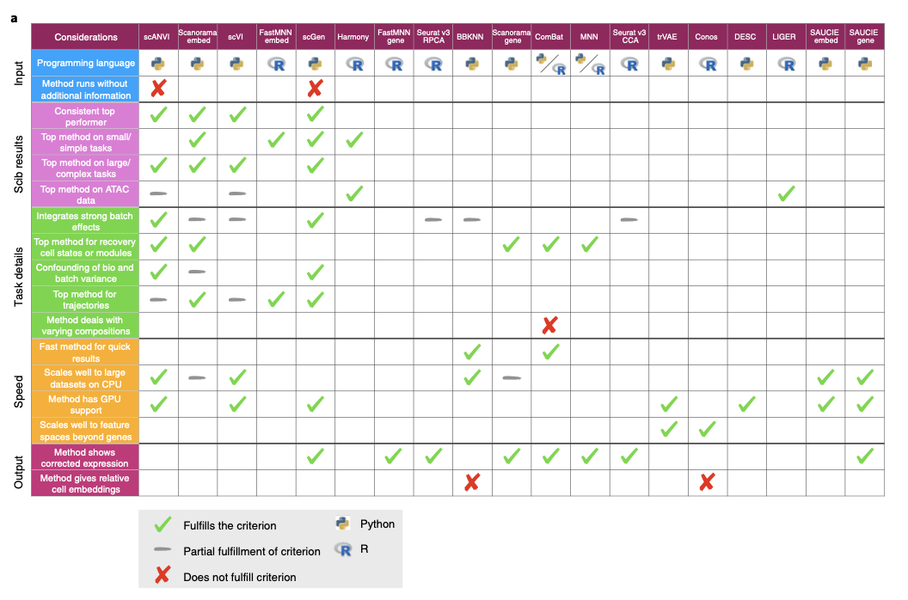
Choosing a batch correction tool depends on your data and your questions
Lücken et al., 2022
https://doi.org/10.1038/s41592-021-01336-8
Notes:
David

Slide 14
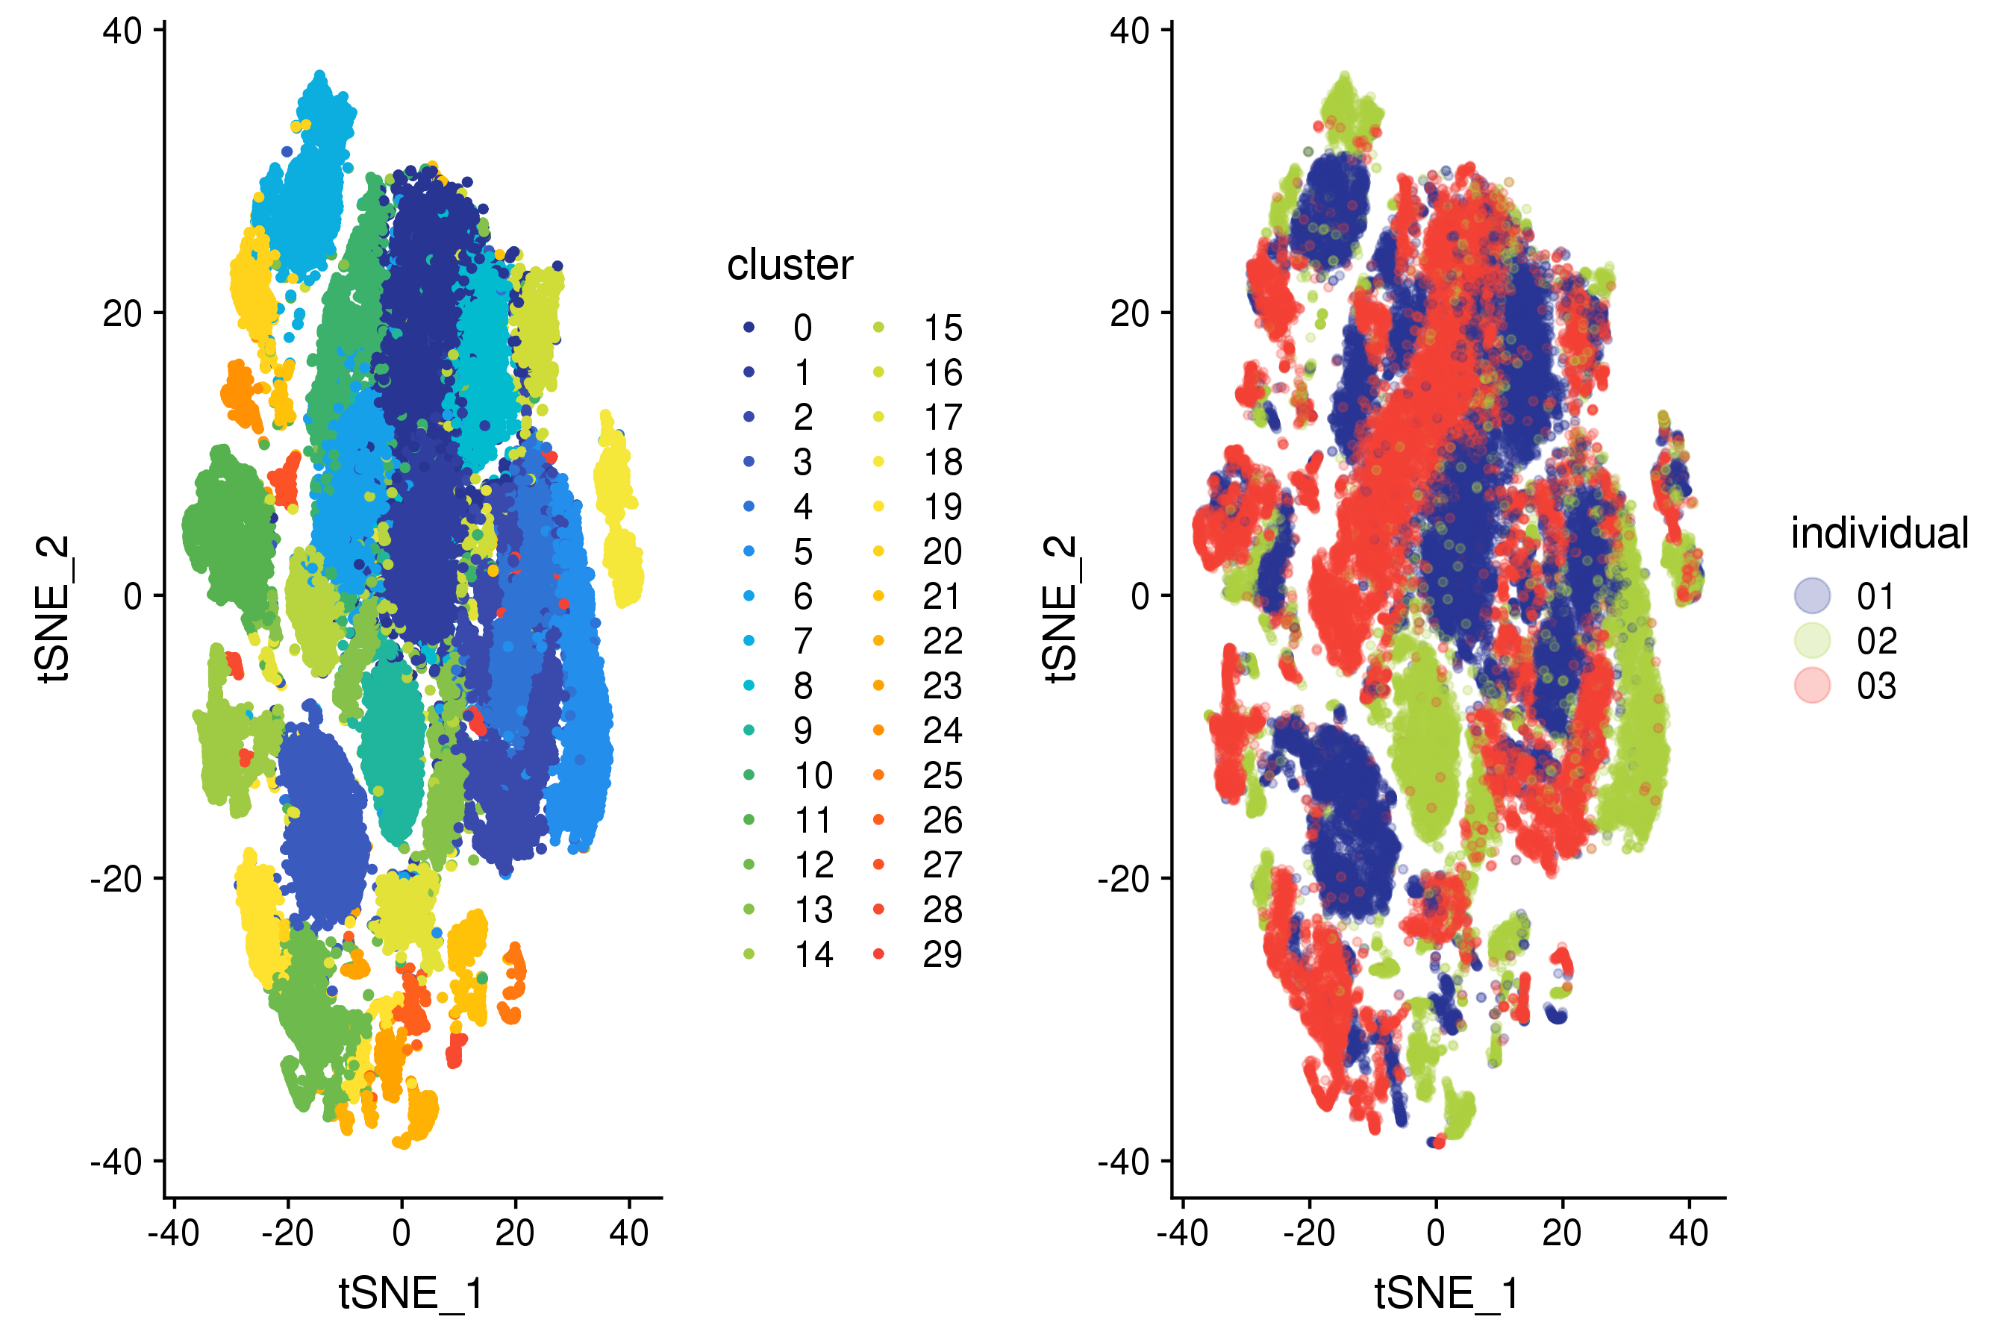
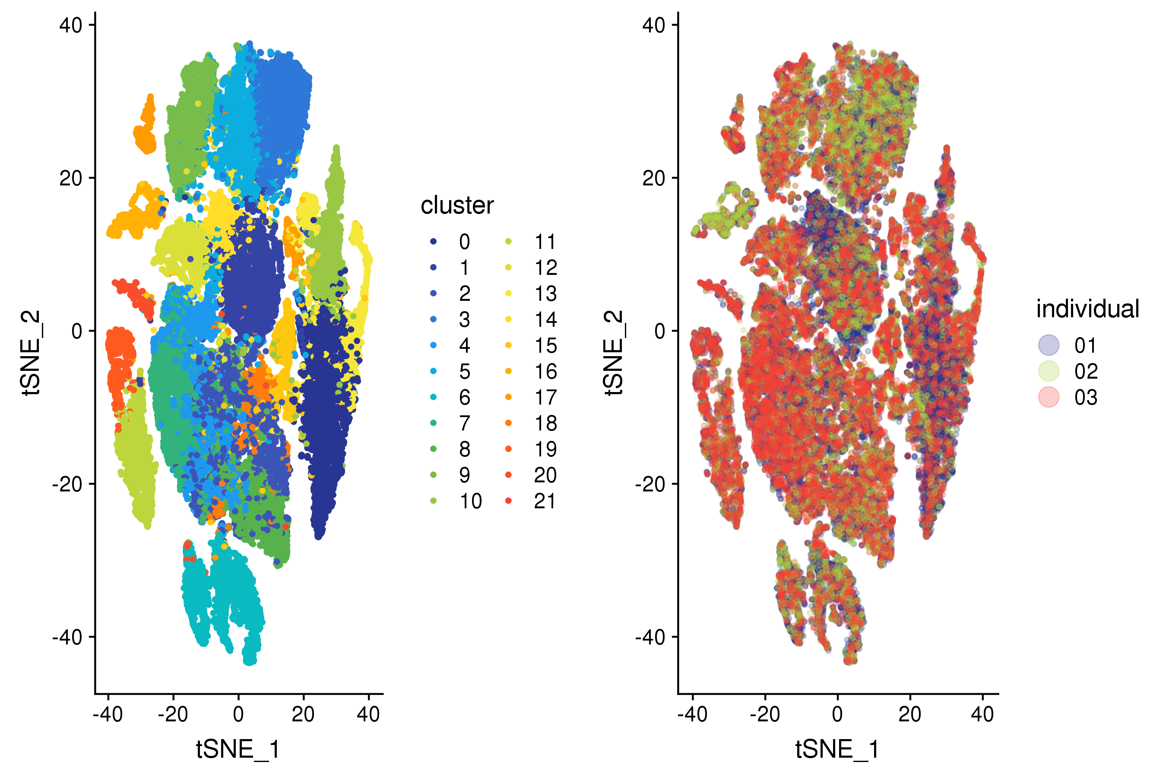
Batch correction is often required for analyzing patient samples
batch correction
Notes:
Ultimately, we want to do joint analyses of many samples from within same tissue or across different tissues. Combining samples increases our power in many analyses, but requires performing batch corrections. As we can see, nuclei clusters are largely driven by which individual they came from, even though we know that different samples have a common set of cell types.

Slide 15
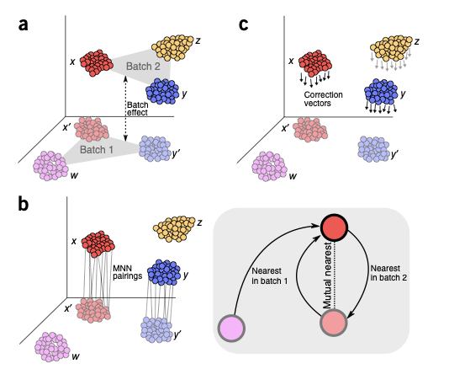
Nearest neighbor graph-based batch correction
One can often discover structure in a single data set using a k-nearest neighbor graph, e.g. implicit in UMAP and Louvain and Leiden clustering.
Similarly, one can consider mutual nearest neighbors between two data sets to find maps that recover similarities that are lost if batch effects confound the overall nearest neighbor graph.
Haghverdi et al., 2019
https://doi.org/10.1038/nbt.4091
Notes:
David

Slide 16
Canonical Correlation Analysis (CCA)
CCA finds the linear combinations of variables across two datasets that are maximally correlated with one another.
The first pair of canonical variables maximizes the correlation across datasets.
The second pair of canonical variables maximizes the correlation subject to the constraint of not being correlated with the first pair, and so on.
Goals of CCA
Similar to Principal Components Analysis (PCA)
Dimensional reduction: explain covariation between datasets with a small number of linear combinations of variables
https://www.mathworks.com
https://github.com/mhaghighat/ccaFuse

Slide 17
Combining CCA and Mutual Nearest Neighbors (Seurat v3)
Stuart et al. Cell (2019) 177(7):1888-1902.
Notes:
To overcome this, we first jointly reduce the dimensionality of both datasets using diagonalized canonical correlation analysis (CCA), then apply L2-normalization to the canonical correlation vectors (Figure 1A,B). We next search for MNNs in this shared low-dimensional representation.
each anchor pair was assigned a score based on the shared overlap of mutual neighborhoods for the two cells in a pair (Figure 1 D; Methods). High-scoring correspondences therefore reflect cases where many similar cells in one dataset are predicted to correspond to the same group of similar cells in a second
dataset, reflecting increased robustness in the association between the anchor cells.
Therefore, for each cell in the query dataset, we aim to apply a transformation (correction vector) that represents a weighted average across multiple batch vectors. These weights are determined by two components: a cell similarity score, computed individually for each cell in the dataset, and the anchor score, computed once for each anchor. The cell similarity score is defined by the distance between each query cell and its k nearest anchors in principal component space (Methods), prioritizing
anchors representing a similar biological state.

Slide 18
Combining CCA and Mutual Nearest Neighbors (Seurat v3)
Human and mouse pancreas datasets
Stuart et al. Cell (2019) 177(7):1888-1902.

Slide 19
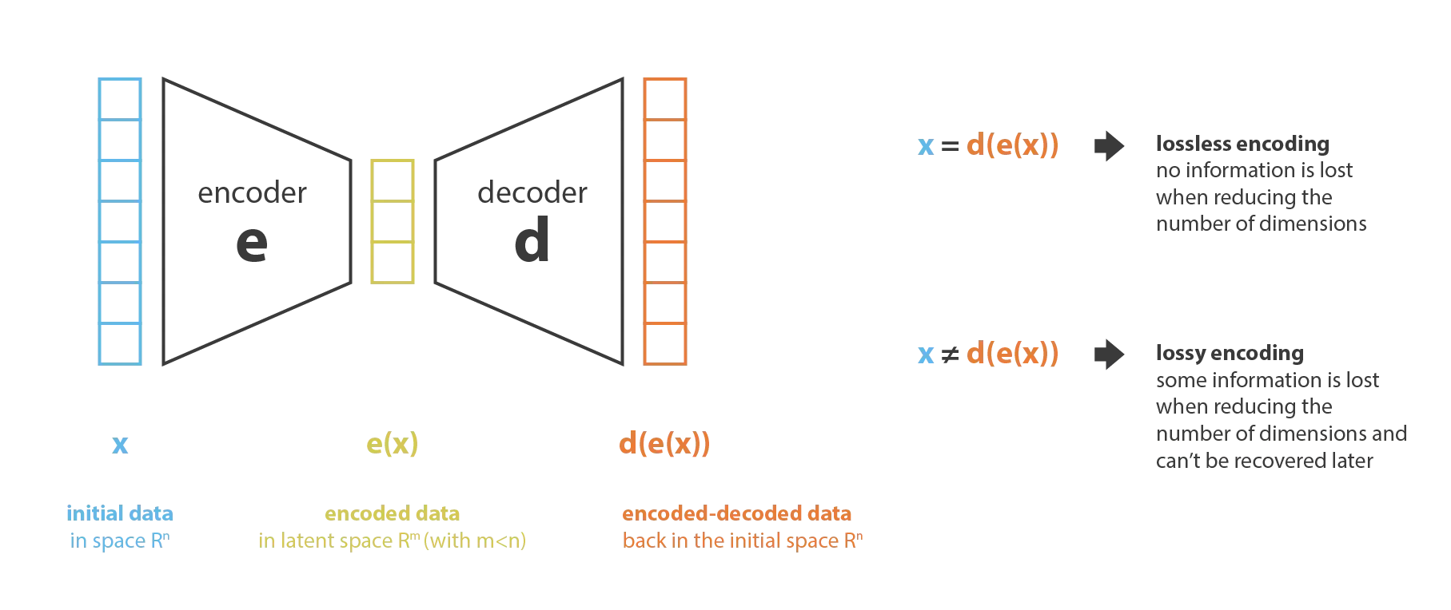
Variational autoencoders: scVI, SCANVI, scGen, …
Variational autoencoders can correct for batch effects through conditional variables (conditional variational autoencoders).
The “integrated data” is the embedding in the latent space.
scVI architecture
Joseph Rocca
Notes:
David

Slide 20
Today’s Outline
Sources of batch effects
Computational approaches to correct for batch effects and integrate data
Examples of data integration

Slide 21
Batch correction examples
Seurat Integration
scVI
Notes:
Sergio

Slide 22
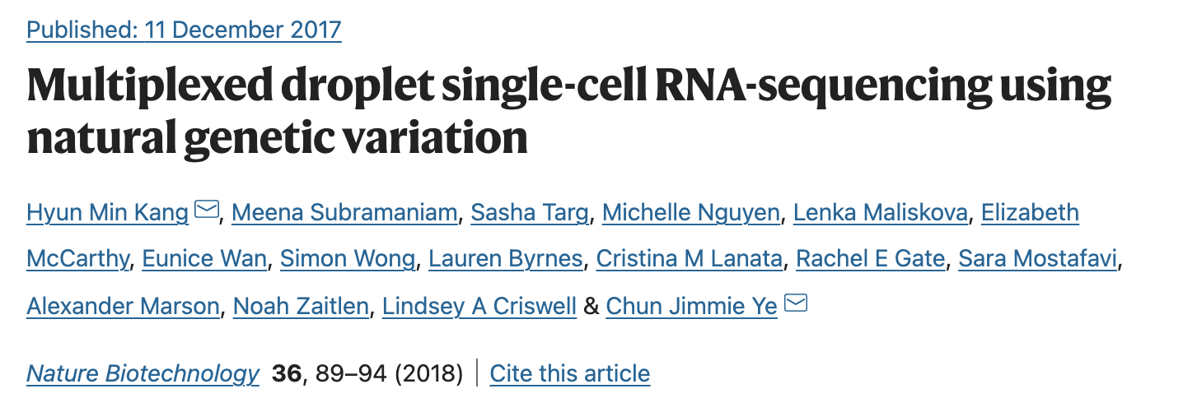
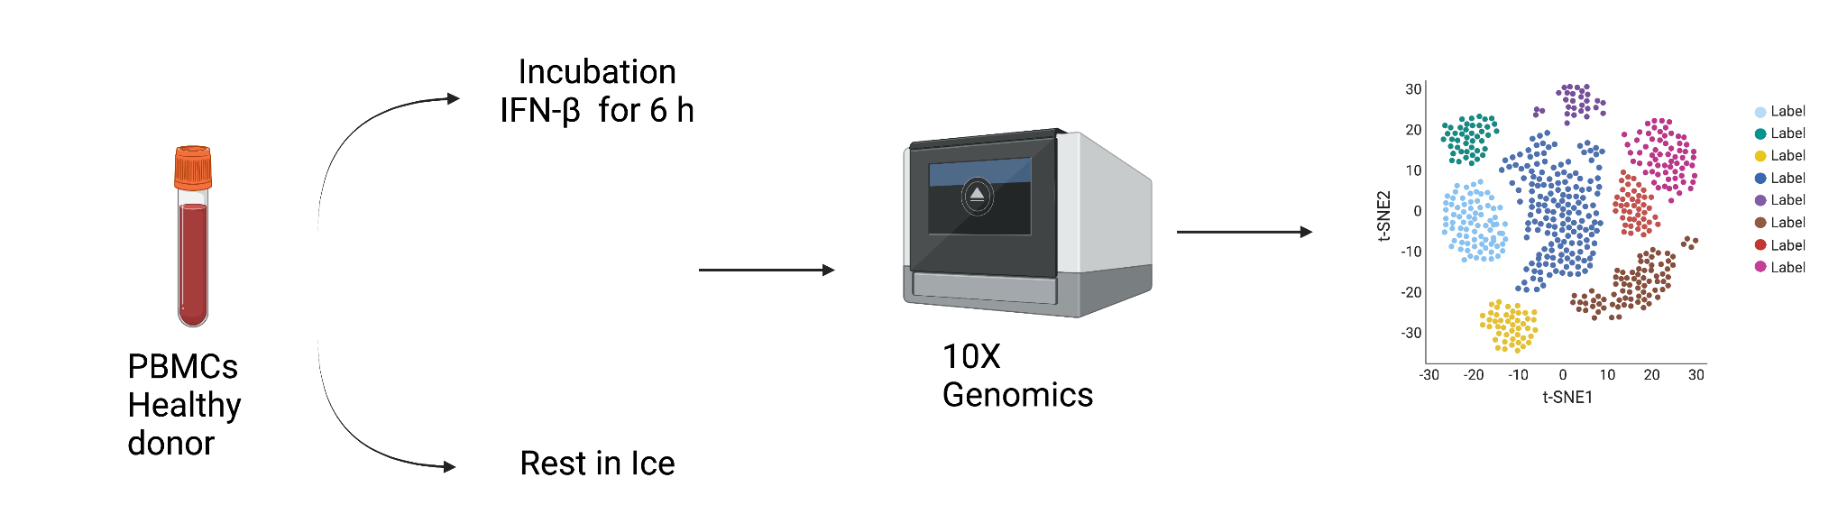
Example dataset for batch correction
Kang, H., Subramaniam, M., Targ, S. et al. (2018). https://doi.org/10.1038/nbt.4042
Notes:
Sergio

Slide 23
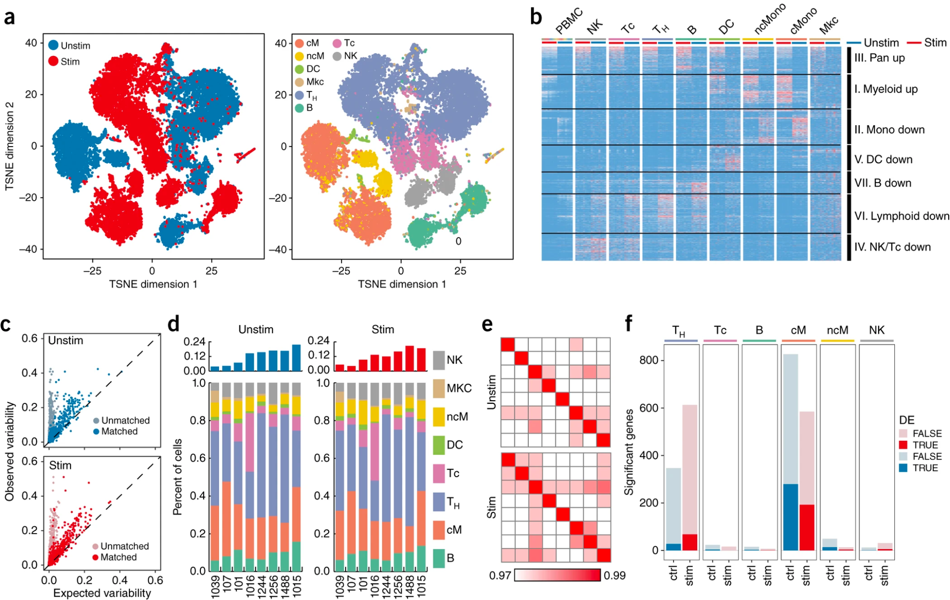
Example dataset for batch correction
Kang, H., Subramaniam, M., Targ, S. et al. (2018). https://doi.org/10.1038/nbt.4042
Notes:
Sergio

Slide 24
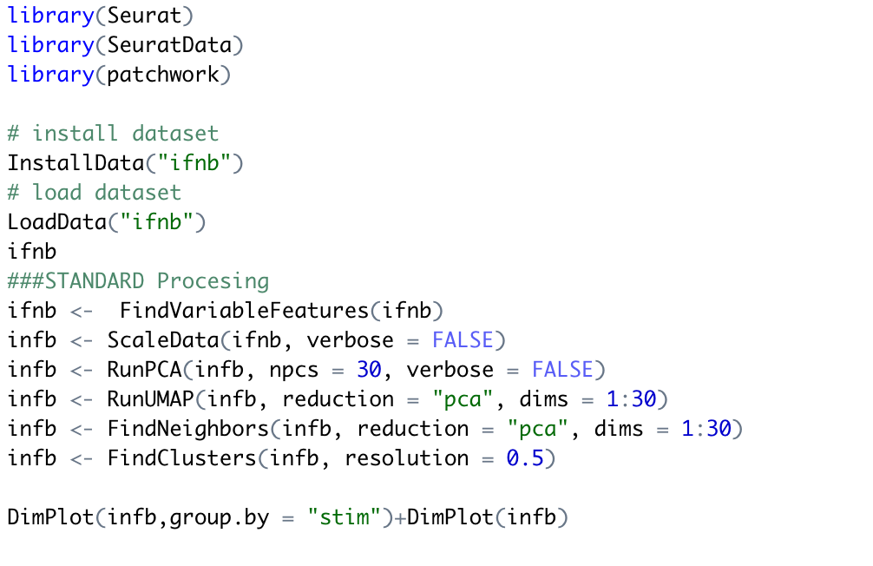
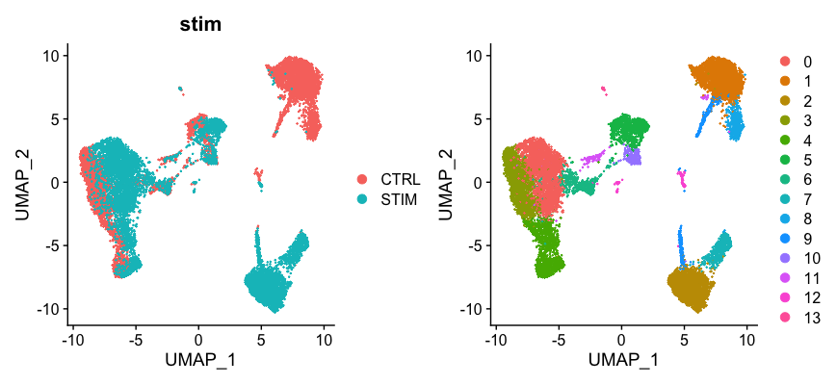
Seurat analysis with no integration
https://satijalab.org/seurat/articles/integration_introduction.html

Slide 25
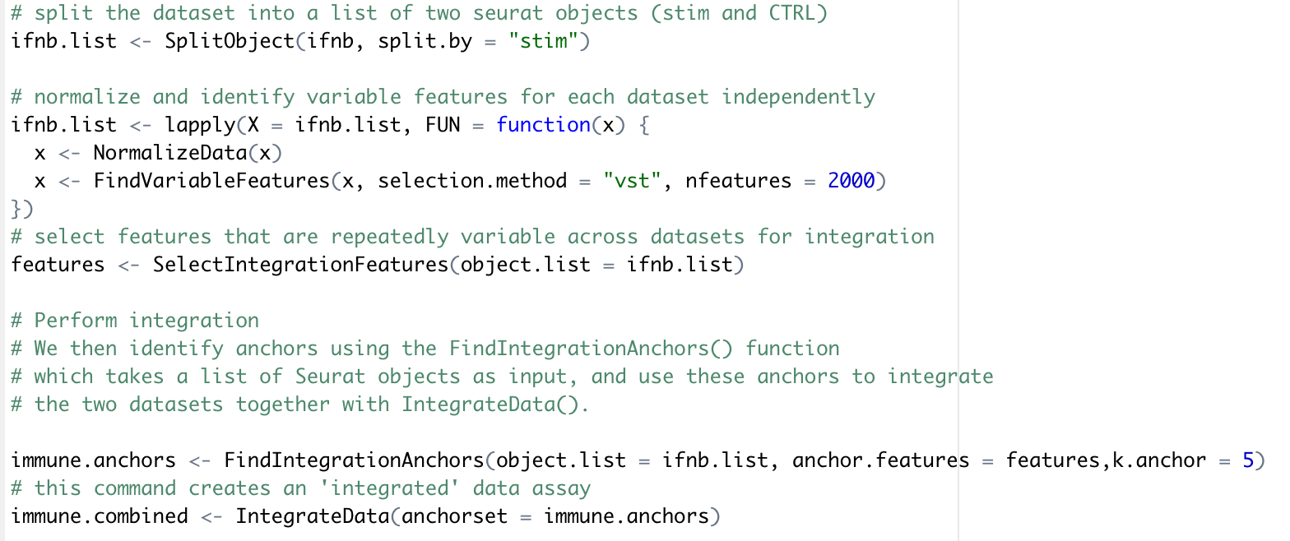
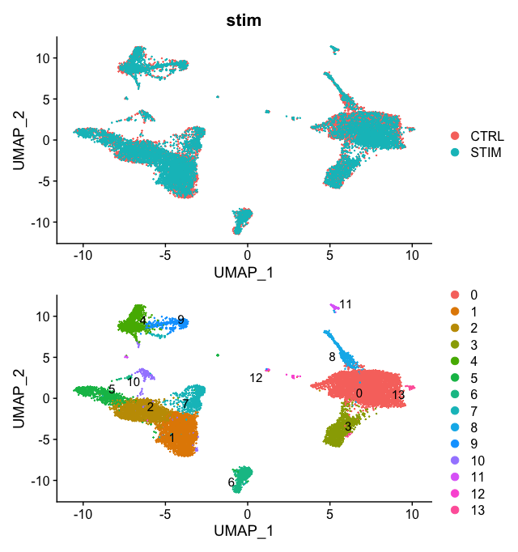
Seurat integration with canonical correlation analysis
https://satijalab.org/seurat/articles/integration_introduction.html

Slide 26
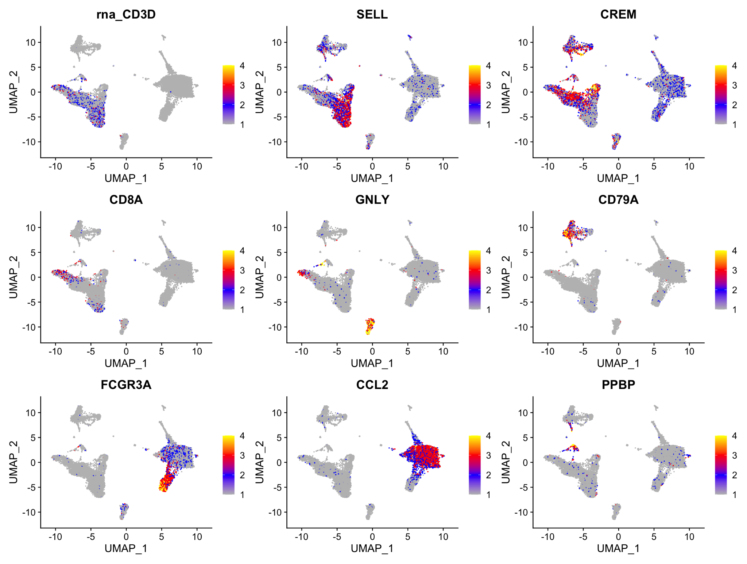
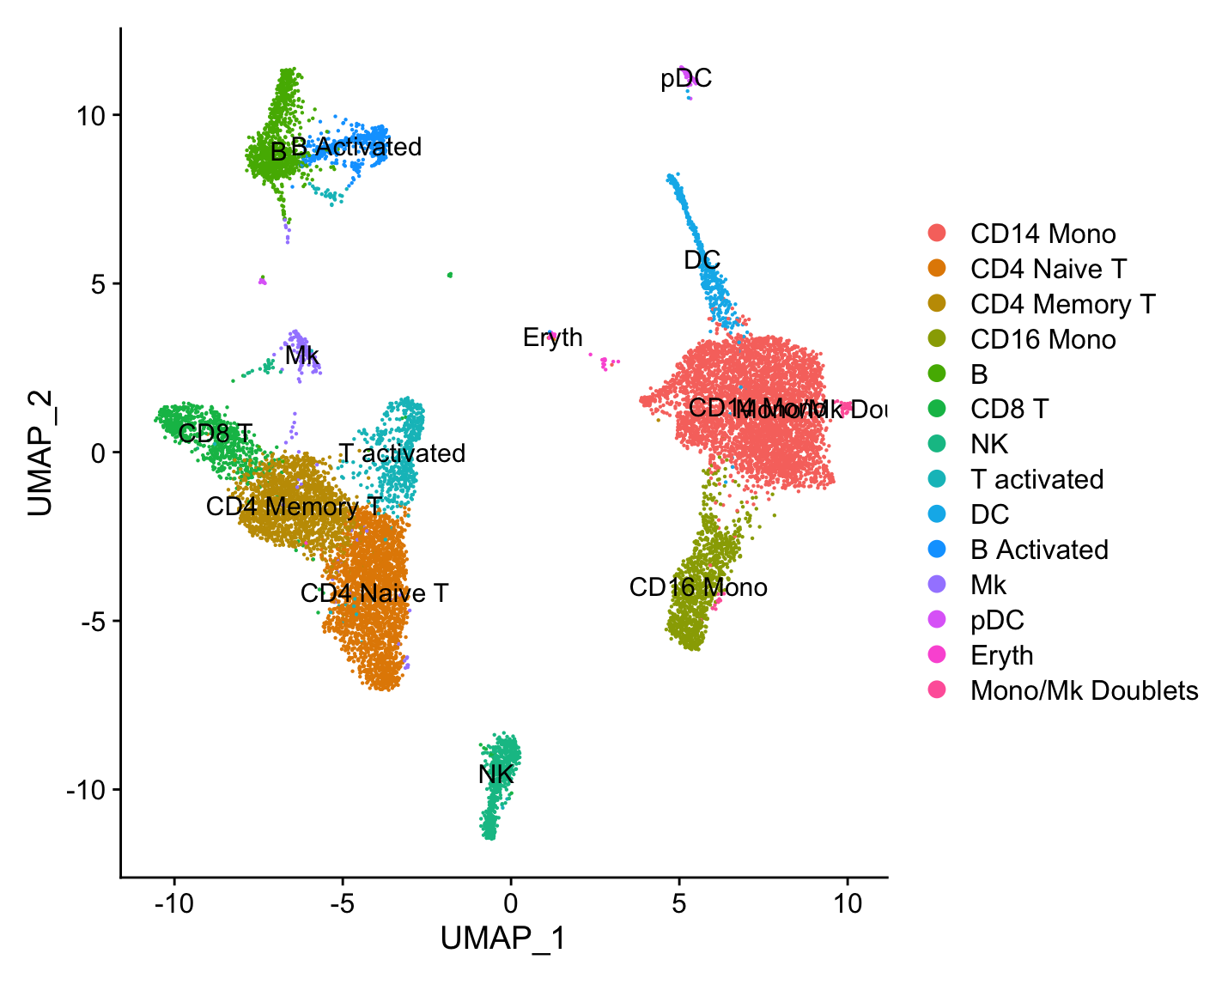
Seurat integration with canonical correlation analysis
https://satijalab.org/seurat/articles/integration_introduction.html

Slide 27
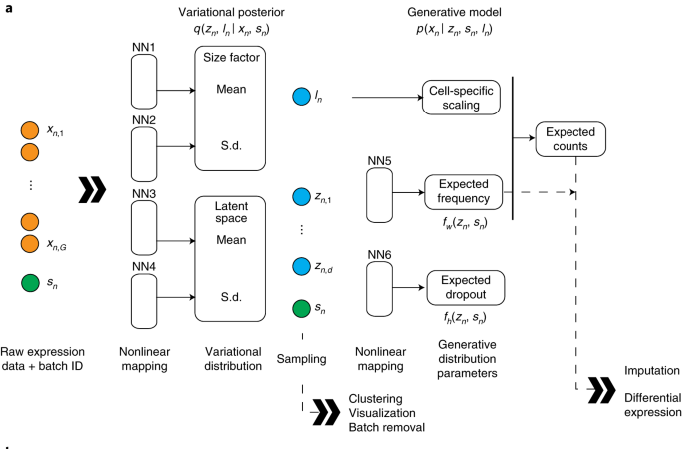
Data integration with SCVI
Lopez, R., Regier, J., Cole, M.B. et al. 2018 . Nat Methods
Notes:
Given a gene expression matrix with batch annotations as input, scVI learns a nonlinear embedding of the cells that can be used for multiple analysis tasks. a, The neural networks used to compute the embedding and the distribution of gene expression. NN, neural network. fw and fh are functional representation

Slide 28
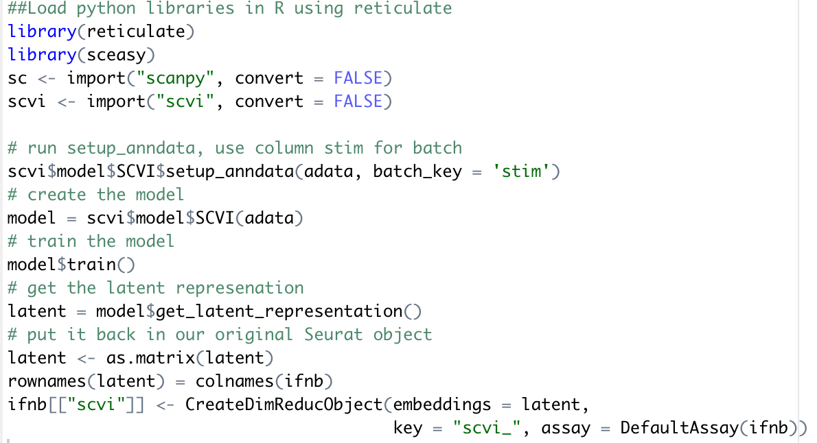
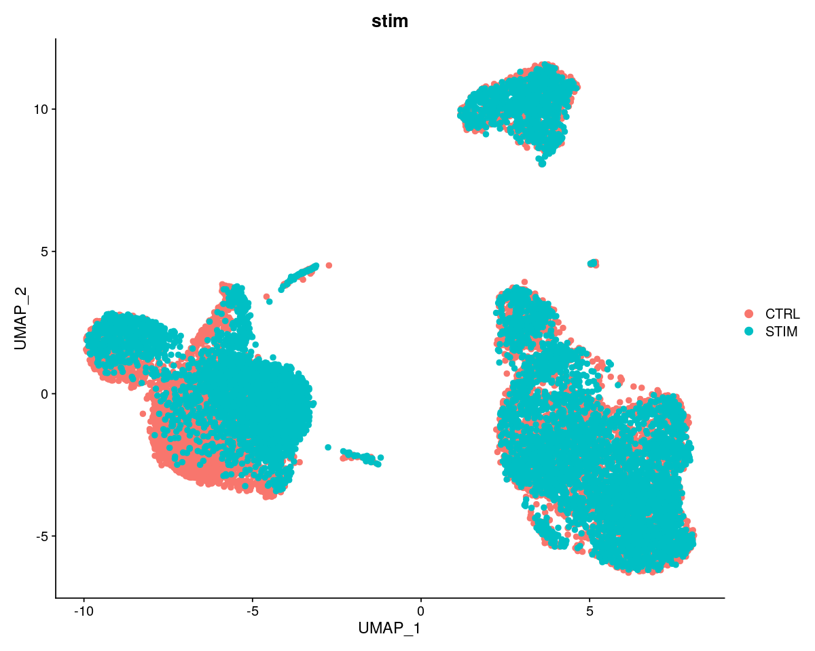
Data integration with SCVI
https://docs.scvi-tools.org/en/stable/tutorials/notebooks/scvi_in_R.html
Notes:
Given a gene expression matrix with batch annotations as input, scVI learns a nonlinear embedding of the cells that can be used for multiple analysis tasks. a, The neural networks used to compute the embedding and the distribution of gene expression. NN, neural network. fw and fh are functional representation

Slide 29
Can we integrate data across measurement types?

Slide 30
Classifying nuclei from a single cell ATAC-seq experiment using single cell RNA-seq data as a reference
Integrating data modalities
14,249 cells from scRNA-seq and 2,548 cells from scATAC-seq
Stuart et al. Cell (2019) 177(7):1888-1902.

Slide 31
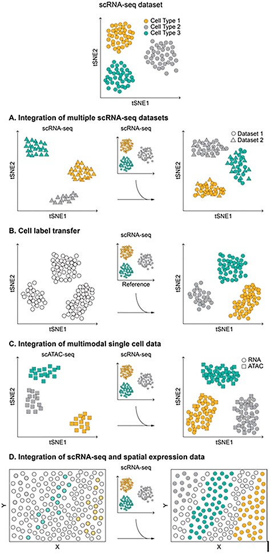
What other types of data integrations are there?
Mattia Forcato, Oriana Romano, Silvio Bicciato, Briefings in Bioinformatics, 2021

Slide 32
Extra slides

Slide 33
Batch correction and data modality integration
Seurat v3
LIGER (Linked Inference of Genomic Experimental Relationships)
Conos (Clustering on Network of Samples)
scVI (deep learning approach)

Slide 34
Canonical Correlation Analysis (CCA)
“Effectively, we treat the data sets as multiple
measurements of a gene–gene covariance structure, and search for patterns that are common to the data sets.”
Butler, A, et al. Nature Biotechnology 36.5 (2018): 411.
Notes:
“Effectively, we treat the data sets as multiple measurements of a gene–gene covariance structure, and search for patterns that are common to the data sets.”
Wikipedia: “dynamic time warping (DTW) is one of the algorithms for measuring similarity between two temporal sequences”

Slide 35
Canonical Correlation Analysis (CCA)
Assessing the performance of batch correction
“For every cell, we calculate how many of its k nearest-neighbors belong to the same data set and average this over all cells. If the data sets are well-aligned, we would expect that each cells’ nearest neighbors would be evenly shared across all data sets.”
Butler, A, et al. Nature Biotechnology 36.5 (2018): 411.

Slide 36
Mutual Nearest Neighbors
“If a pair of cells from each batch is contained in each other’s set of nearest neighbors, those cells are considered to be mutual nearest neighbors. We interpret these pairs as containing cells that belong to the same cell type or state despite being generated in different batches. Thus, any systematic differences in expression level between cells in MNN pairs should represent the batch effect.”
Haghverdi, L, et al. Nature biotechnology 36.5 (2018): 421.
Notes:
Where could this go wrong? Are there cases where cells from batches could be labeled as mutually nearest neighbors but that would be a bad correction to make? One such example could be cells in different states: for example cytotoxic T cells and naïve T cells. MNN correction might lose information about cell states.

Slide 37
Mutual Nearest Neighbors
4 pancreas datasets
Haghverdi, L, et al. Nature biotechnology 36.5 (2018): 421.

Slide 38
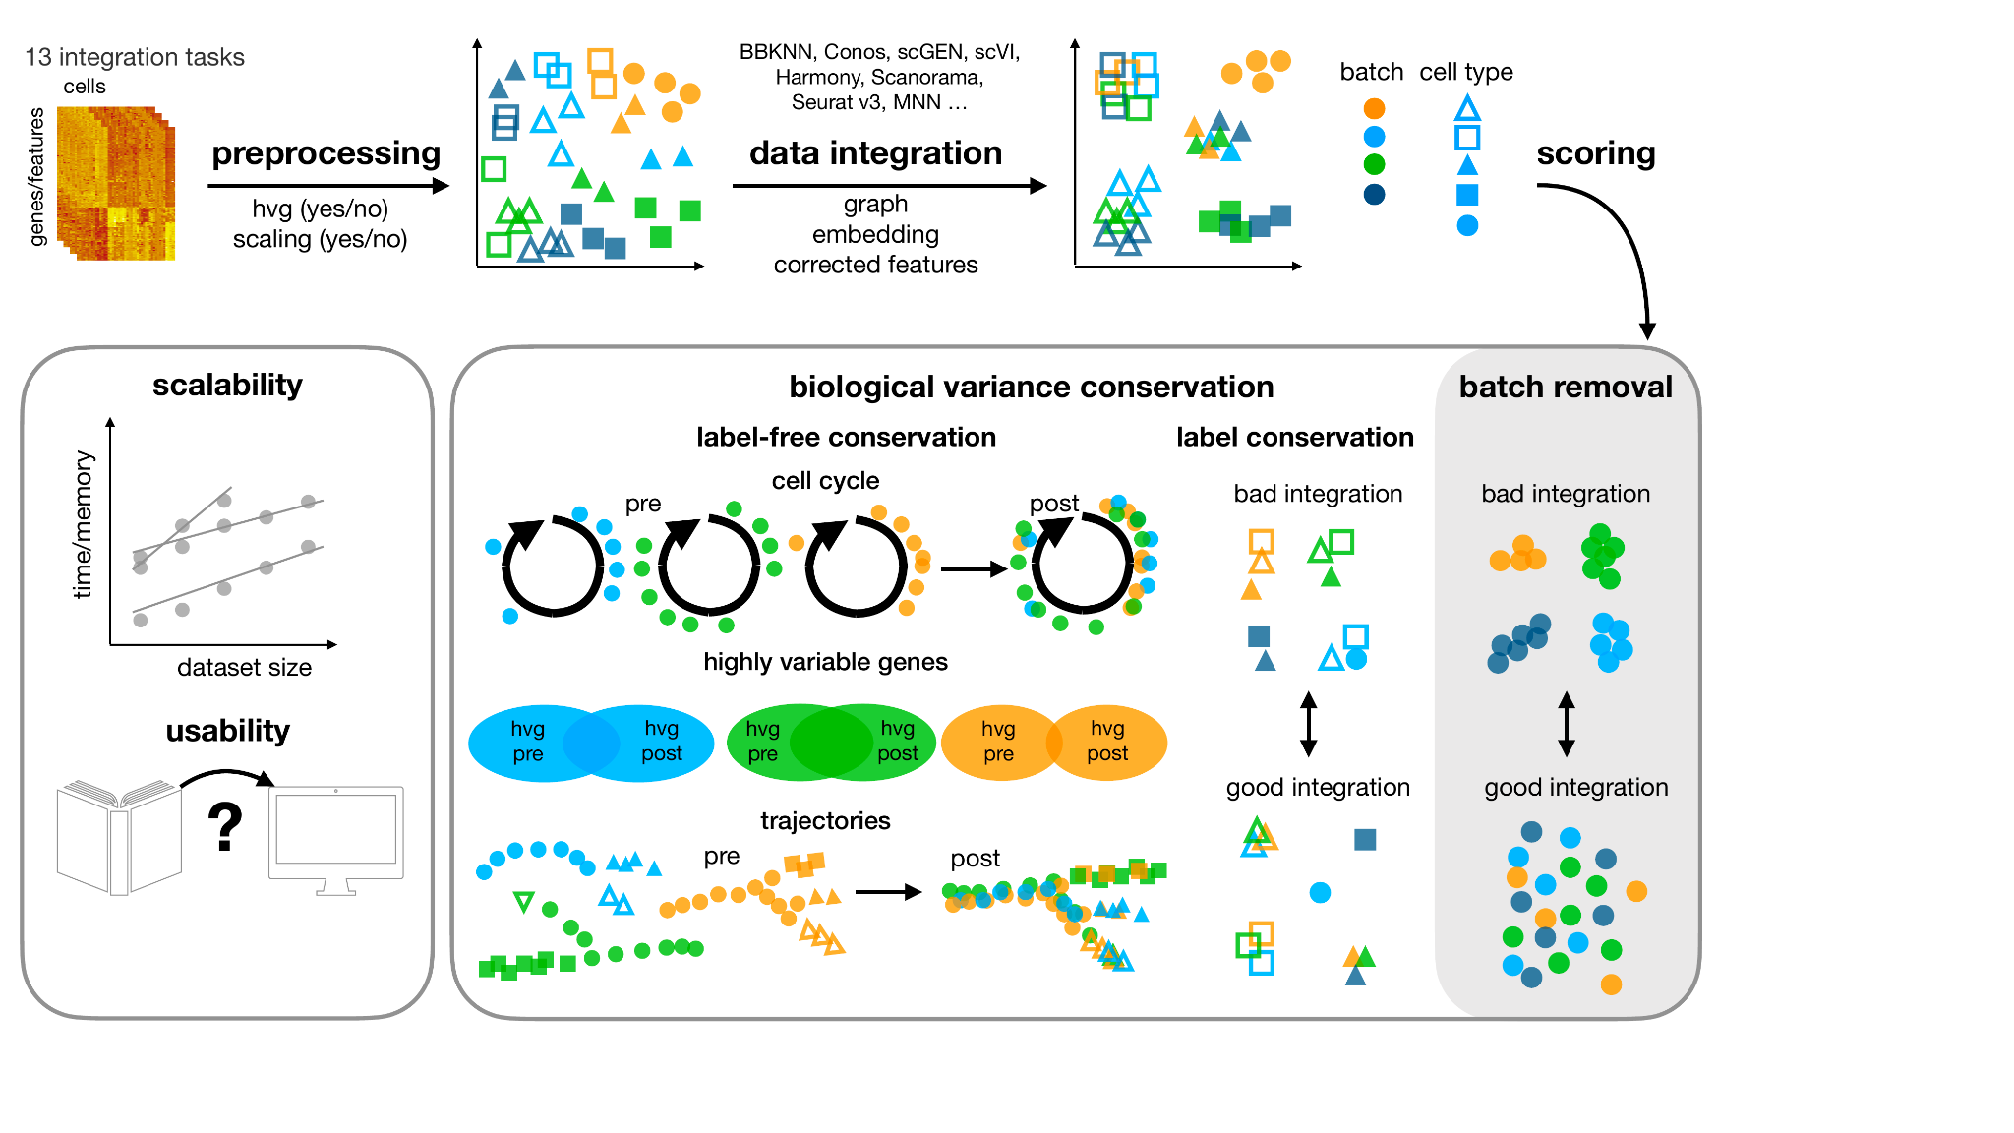
Benchmark example
Luecken, M.D., Büttner, M., Chaichoompu, K. et al. Nat Methods 19, 41–50 (2022)

Slide 39
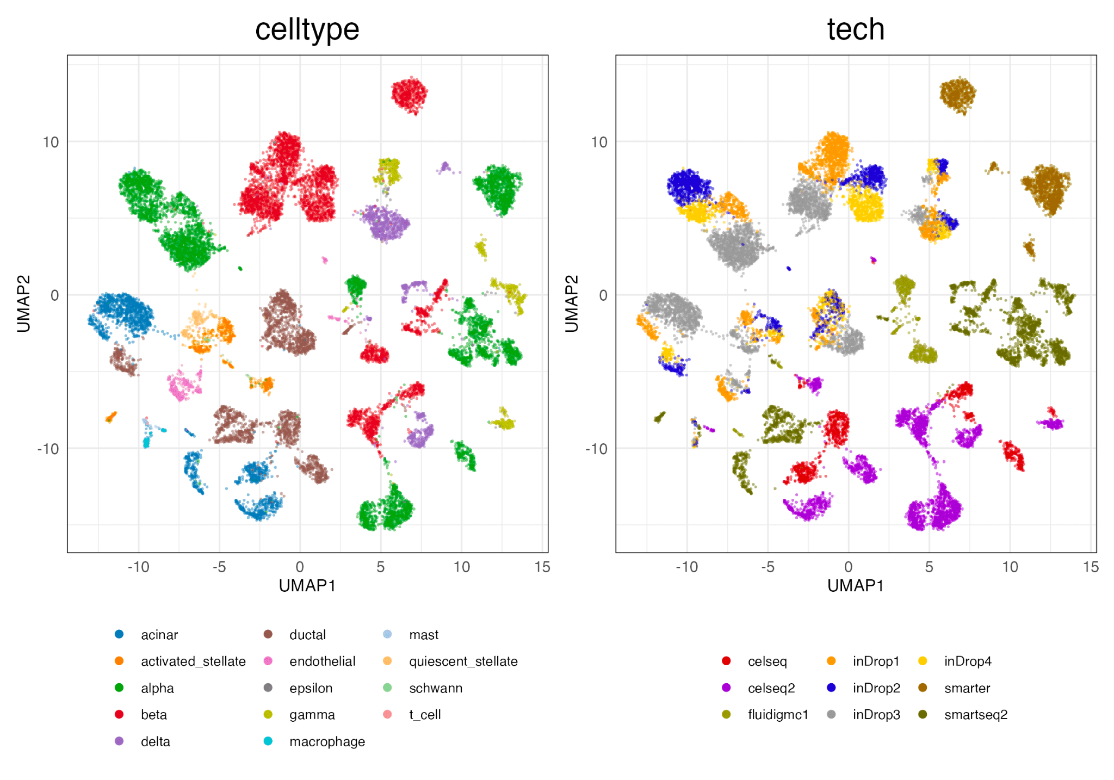
Benchmark example
https://theislab.github.io/scib-reproducibility/index.html

Slide 40
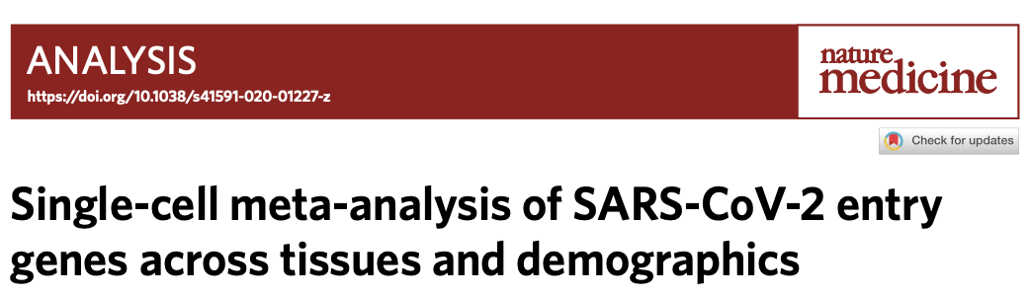
Why do large cohort studies?
Some effects are difficult to attribute to patient-level covariates if those are confounded.
e.g.: How do smoking status and age contribute to virus entry-related genes in lung cells?
Challenge: age and smoking status are highly correlated
Muus et al., 2021
https://doi.org/10.1038/s41592-021-01336-8
Notes:
David

Slide 41
Examples of problems posed by large cohort studies
Technical batch effects confound biological variation of interest:
Site and time of collection
Experimental protocol used
Different sources of biological variation confound biological variation of interest:
Cell cycle
Anatomy of sampling
→ Often requires data integration!
Notes:
David

Slide 42
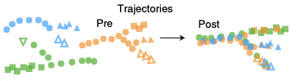
What is data integration?
Data integration aims to display only variation that is key to understand a cellular system while collapsing variation that is mainly due to “batch effects” that do not serve the understanding of the process in question.
Batch effects can be variation between biological replicates or experimental protocols for example.
Lücken et al., 2022
https://doi.org/10.1038/s41592-021-01336-8
Notes:
David

Slide 43
Mutual Nearest Neighbors
Datasets simulated from a Gaussian mixture model
What are pros and cons of using simulation to assess a computational method?
Haghverdi, L, et al. Nature biotechnology 36.5 (2018): 421.

Slide 44
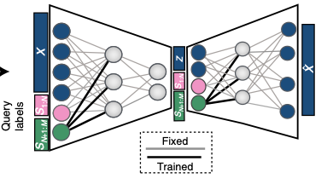
Architecture Surgery: scArches
As an extension to CVAEs, models can be set up for training such that only parameters relevant for the condition effects in the forward pass are trained.
Using this type of training schedule, data integration models can be fit very quickly and convergence can be guided.
Lotfollahi et al., 2021
https://doi.org/10.1038/s41587-021-01001-7
Notes:
David

Slide 45
VAEs: scVI, SCANVI, scGen, …
Variational autoencoders can correct for batch effects through conditional variables (conditional variational autoencoders).
The “integrated data” is the embedding in the latent space.
Methods differ in:
The use of auxiliary information: SCANVI uses cell type annotation to improve mapping of cells between conditions where scVI does not require this type of information.
The exact architecture of the VAE and its training. Note: the data is only integrated if the model converged well during training, this may result in differential performance between examples!
Notes:
David

Slide 46
Batch correction and data modality integration
Nonnegative Matrix Factorization (NMF)
“Our goal is to find a small number of metagenes, each defined as a positive linear combination of the N genes. We can then approximate the gene expression pattern of samples as positive linear combinations of these metagenes. Mathematically, this corresponds to factoring matrix A into two matrices with positive entries, A ∼ WH.”
Brunet J. et al. (2004) PNAS. 101:12, 4164-4169.

Slide 47
Batch correction and data modality integration using LIGER
LIGER implements non-negative matrix factorization
Welch, et al. Cell (2019) 177(7): 1873-1887.
Notes:
Identifying shared and dataset-specific factors through integrative non-negative matrix factorization (iNMF).

Slide 48
Batch correction and data modality integration using LIGER
LIGER implements non-negative matrix factorization
Welch, et al. Cell (2019) 177(7): 1873-1887.

Slide 49
Integrating blood cell datasets using LIGER
Higher alignment score = better data integration
Welch, et al. Cell (2019) 177(7): 1873-1887.

Slide 50
Integrating blood cell datasets using LIGER
Ideally, divergent cell types should not cluster together after batch correction.
Welch, et al. Cell (2019) 177(7): 1873-1887.

Slide 51
In situ spatial transcriptomic data in mouse frontal cortex
STARmap
Wang, X. et al. Science (2018): eaat5691.

Slide 52
Using LIGER to integrate single-cell transcriptomic and
in situ spatial transcriptomic data
71,000 cells from scRNA-seq
2,500 cells from STARmap
What are advantages of integrated analysis of these 2 datasets?
Welch, et al. Cell (2019) 177(7): 1873-1887.
Notes:
“Integrated analysis of spatial transcriptomic and scRNA-seq data using LIGER could offer two potential advantages compared to separate analyses of the two data modalities: (1) assigning spatial locations to cell clusters observed in data from dissociated cells; and (2) increasing the resolution for detecting cell clusters from the in situ data. ”

Slide 53
Using LIGER to integrate single-cell transcriptomic and
single-cell DNA methylation data
56,000 cells from scRNA-seq
3,000 cells from DNA methylation
“We reasoned that, because gene body methylation is generally anticorrelated with gene expression, reversing the direction of the methylation signal would allow joint analysis.”
Welch, et al. Cell (2019) 177(7): 1873-1887.

Slide 54
Batch correction and data modality integration using Conos
Conos (Clustering on Network of Samples)
Barkas, et al. Nature Methods (2019) 16, 695–698.

Slide 55
Batch correction with deep learning approaches
Autoencoders and variational autoencoders are popular frameworks for embedding single cell genomics datasets.
http://kvfrans.com/variational-autoencoders-explained/

Slide 56
Batch correction with deep learning approaches
single-cell variation inference (scVI)
Lopez, et al. Nature Methods (2018) 15, 1053-1058.

Slide 57
Methods to assess performance of batch correction
Entropy of batch mixing
kBET - k-nearest neighbor batch effect test
Silhouette coefficient
cells of the same cell type are close together and far from other cells of a different type
Adjusted rand index
do batch labels and cluster labels agree with one another?
Biological significance
Notes:
kBET – is local batch label distribution sufficiently similar to the global batch label

Slide 58
Common assumptions during batch correction
At least one cell population is found shared in both datasets.
The batch effect and the biological differences do not overlap with one another (ie orthogonal).
The magnitude and variation of the biological effect you care about is greater than that of the batch effect.

Slide 59
Will batch correction remove biological differences in single cell transcriptomic data? (ChatGPT response)
Batch correction in single-cell transcriptomics is designed to remove technical variations that arise due to differences in the experimental procedures such as sample preparation, sequencing, and data analysis. The goal of batch correction is to reduce technical noise in the data and allow biological differences between cells to be better distinguished.
However, batch correction can potentially remove some biological differences in the data, particularly if the biological differences are correlated with the batch effect. For example, if cells from different batches are isolated from different tissues or at different stages of development, then the batch correction algorithm may inadvertently adjust the expression levels of genes that are differentially expressed between these groups.
Therefore, it is important to carefully evaluate the results of batch correction and to consider the biological context of the data. One approach is to compare the results of batch-corrected data with uncorrected data and to ensure that the biological differences identified in the uncorrected data are still present after batch correction. It is also important to choose an appropriate batch correction method that is suitable for the specific experimental design and to use quality control metrics to ensure that the batch correction has not removed important biological information.

Slide 60
Recent helpful articles on data integration methods
Argelaguet, Ricard, et al. "Computational principles and challenges in single-cell data integration." Nature biotechnology (2021).
Review
Luecken, Malte D., et al. "Benchmarking atlas-level data integration in single-cell genomics." Nature methods (2022).
Methods comparison
Tran, Hoa Thi Nhu, et al. "A benchmark of batch-effect correction methods for single-cell RNA sequencing data." Genome biology (2020).
Methods comparison

